Slide 1


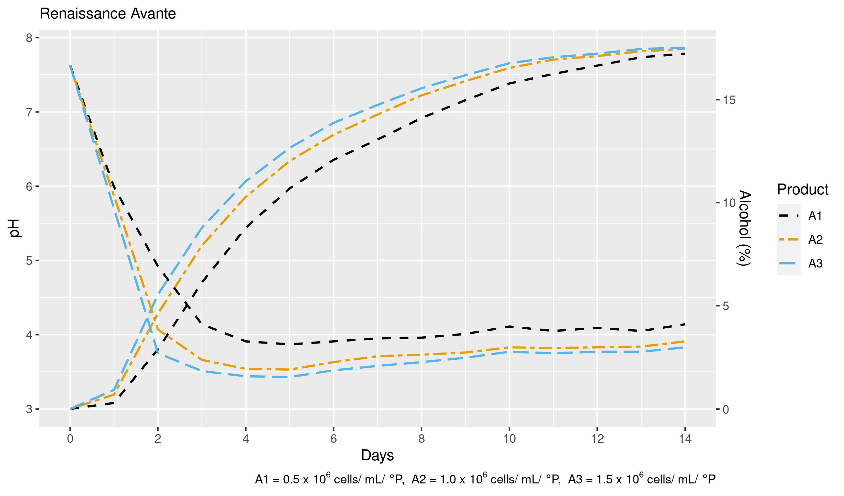
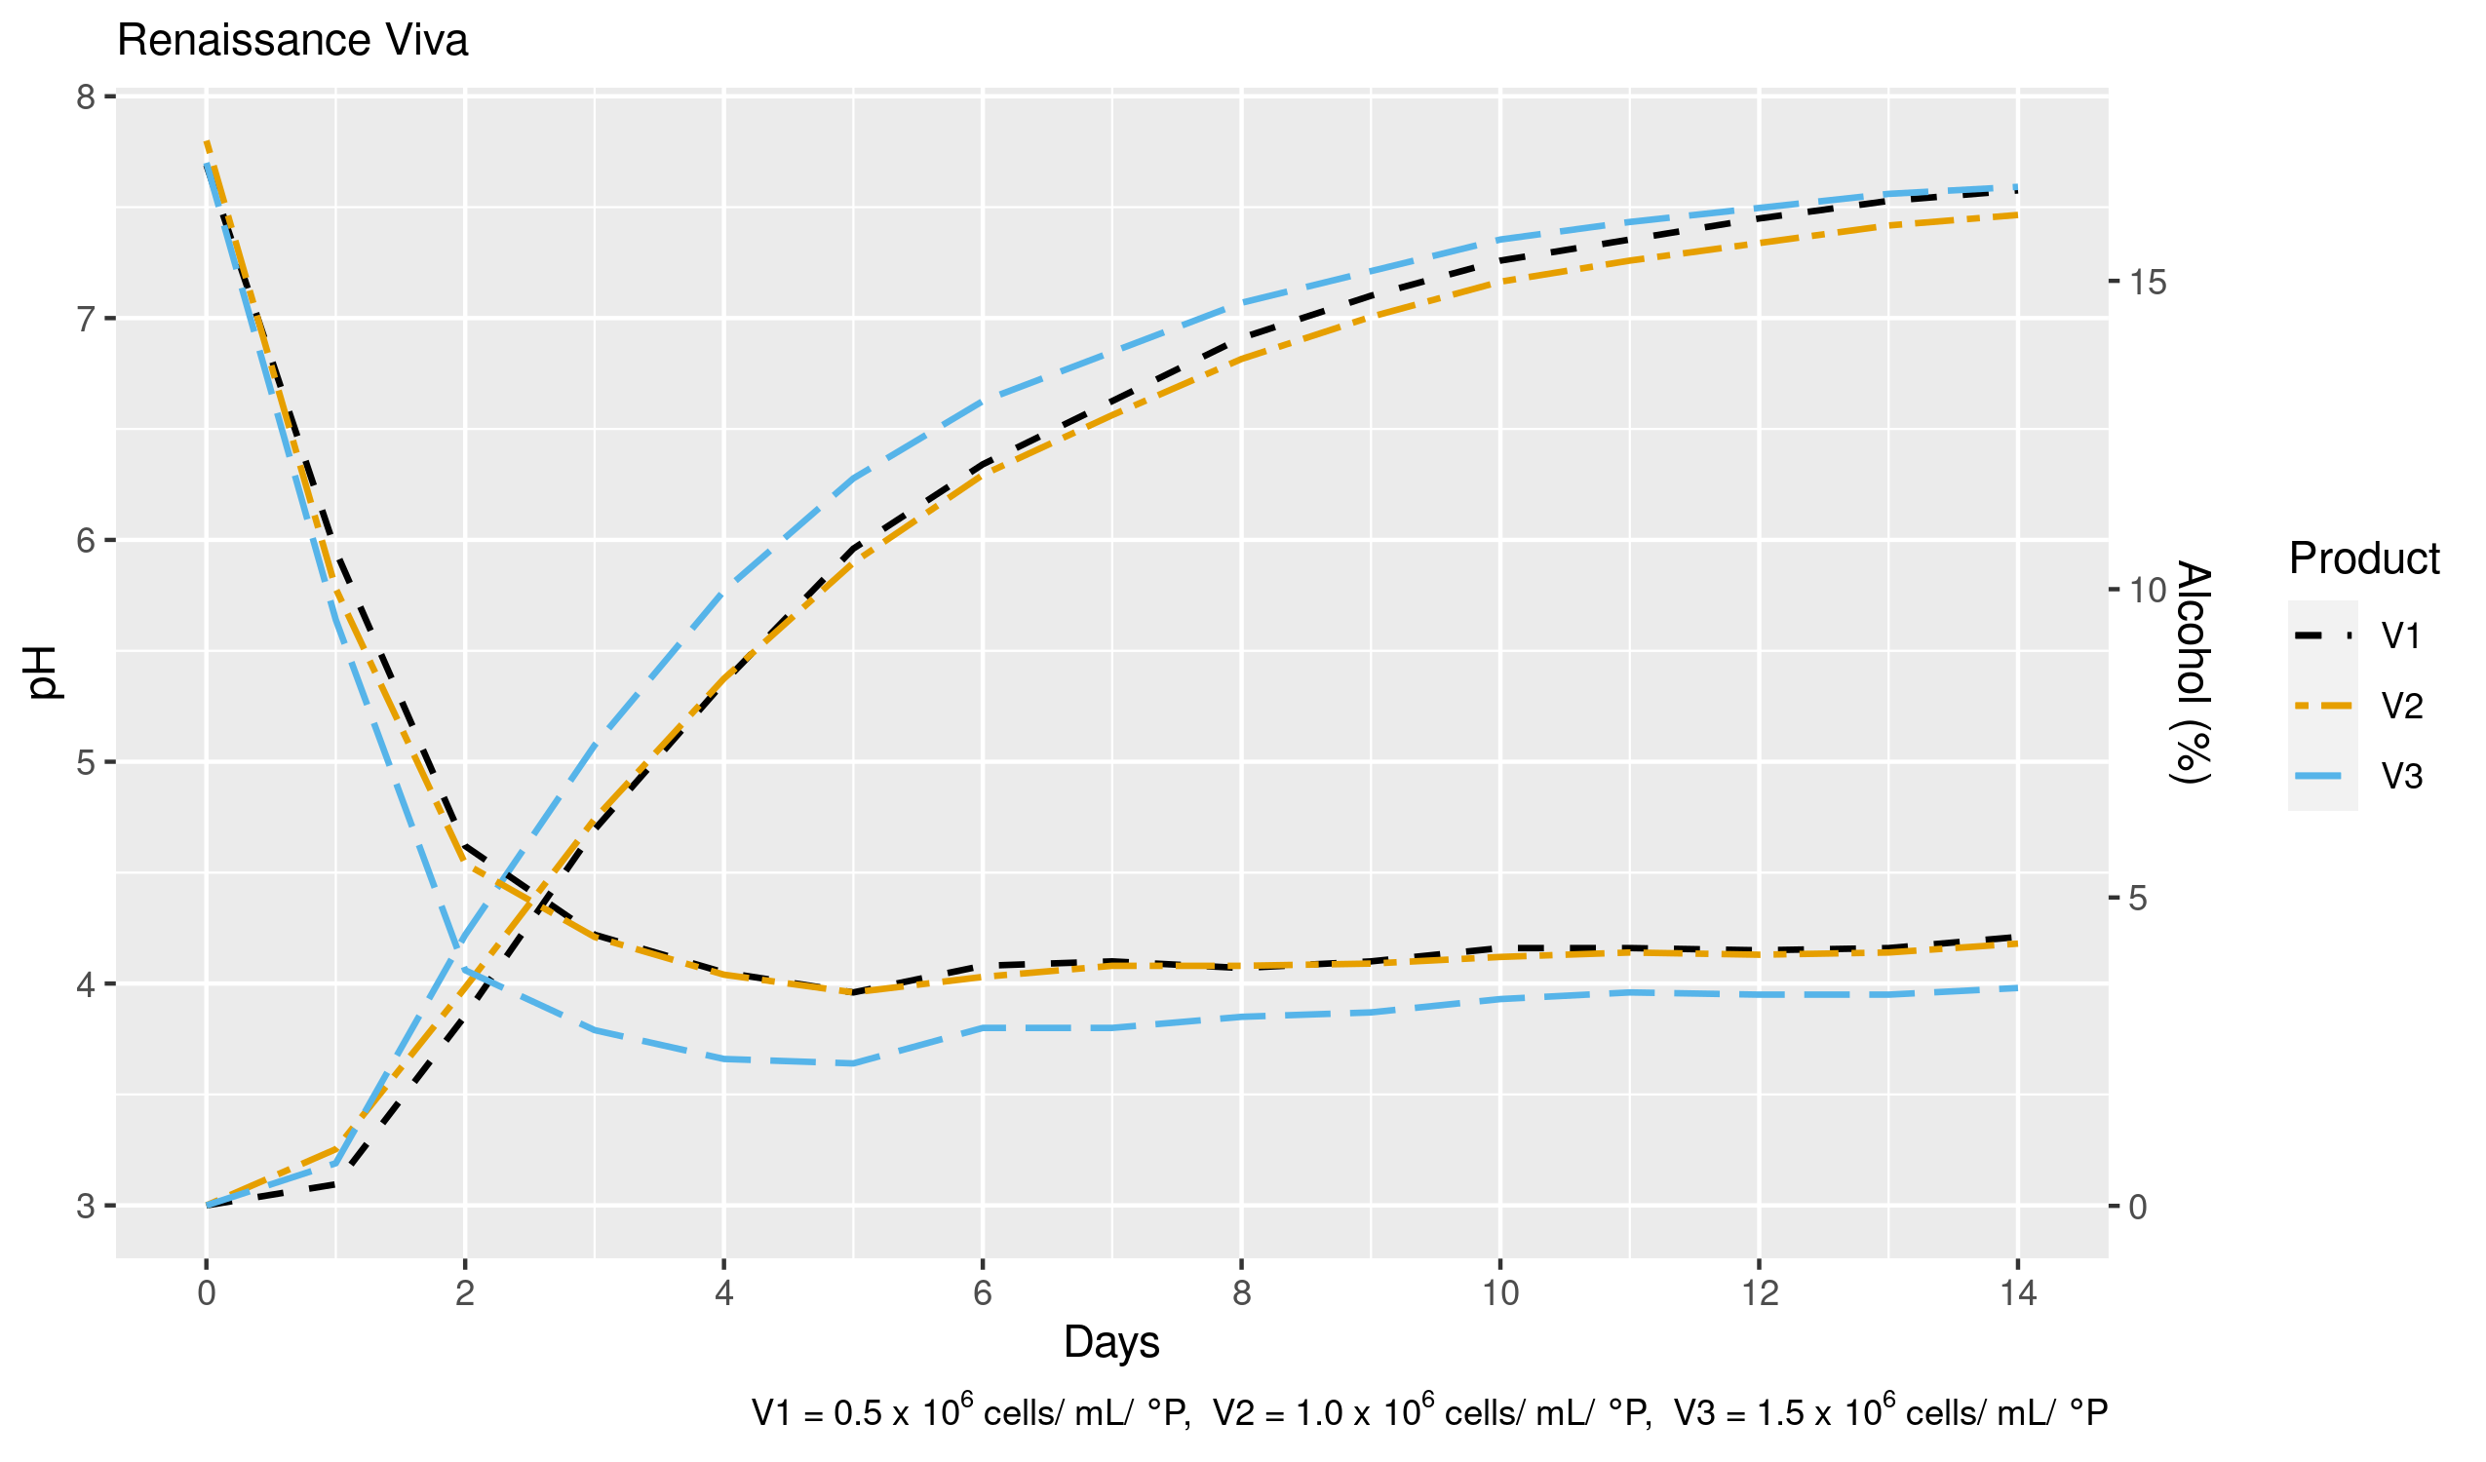
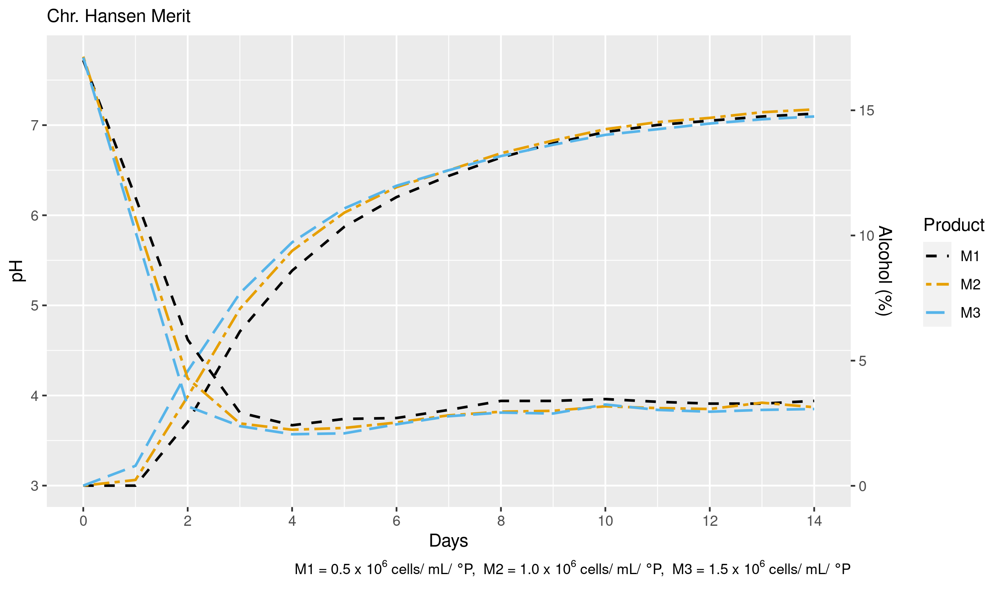
Effects of Yeast Pitch Rate ON High Gravity Hard Seltzer Fermentation with Nutrient Supplementation
Authored By:
Jonathan Denenberg
Chance Raynes
Supervising Researchers:
Daniel C Gusmer, Gusmer Enterprises, Inc.
Eric May, Gusmer Enterprises, Inc.
Jeffrey Callaway, CSU CHHS FSHN FST
INTRODUCTION
METHODS
RESULTS
This experiment was meant to test the performance of Gusmer Enterprises, Inc’s new MicroElements® Hard Seltzer HG yeast nutrient blend on different yeast strains at different pitch rates. As this was a new product, understanding how it performed with different yeast strains is crucial to its use in production spaces. It is already known that nutrient supplementation in seltzer production is necessary, however this experiment aimed to define the nutrient’s impact on fermentation between yeast strains and see if a variation in pitch rate has an effect on overall fermentation kinetics.
Chr. Hansen Viniflora® Merit™, Renaissance Avante™, and Renaissance Viva ™ yeasts were chosen for their high alcohol tolerance and sugar conversion rate. Pitch rates of 0.5x10^6, 1.0x10^6, and 1.5x10^6 cells/mL/°P were chosen. pH, specific gravity, and temperature were tracked and charted daily for 14 days.
All vessels, lids, airlocks, and tools were cleaned and then sanitized
460 grams of powdered dextrose and 6.6 grams of MicroElements® Hard Seltzer HG nutrient were added to each vessel to reach a starting gravity of ~26.5°Plato
9 liters of water were boiled and 1 liter was added to each vessel
Each vessel was then mixed until sugar and nutrient fully dissolved
Each vessel was cooled to 25°C
Each yeast was weighed out to hit desired pitch rates
Each vessel was inoculated with the appropriate yeast and pitch rate
Each vessel was fitted with a lid, airlock, and left at room temperature
Data including pH, temperature, and specific gravity was recorded for 14 days
Final samples were tested for alcohol on an Anton Paar Alcolyzer and DMA 4500 to develop alcohol production curves
HYPOTHESIS
Name | Yeast strain | Pitch rate (cells/mL/°P) | Dry weight (grams)
A1 | Avante ™ | 0.5x10^6 | 0.79
A2 | Avante™ | 1x10^6 | 1.59
A3 | Avante™ | 1.5x10^6 | 2.38
M1 | Viniflora® Merit™ | 0.5x10^6 | 0.39
M2 | Viniflora® Merit™ | 1x10^6 | 0.79
M3 | Viniflora® Merit™ | 1.5x10^6 | 1.18
V1 | Viva™ | 0.5x10^6 | 0.57
V2 | Viva™ | 1x10^6 | 1.15
V3 | Viva™ | 1.5x10^6 | 1.72
The effect of increasing yeast pitch rate in a high Plato substrate deficient in Free Amino Nitrogen (FAN) and micronutrients supplemented with Gusmer MicroElements® Hard Seltzer HG dry yeast nutrient will result in a faster time to complete depletion of fermentable carbohydrates.
BACKGROUND
High gravity dextrose based substrates are deficient in vital nutrients yeast need to grow and multiply.
Nutrients critical to yeast vitality are Free Amino Nitrogen (FAN) sources and other trace minerals, such as calcium and zinc.
The use of nutrient supplement additions into high gravity sugar substrates have shown to greatly improve yeast vitality over the course of the fermentation cycle.
Gusmer Enterprises, Inc. have developed a new nutrient, MicroElements® Hard Seltzer HG, to be tested with their established commercial yeast strains with variable pitch rates.
CONCLUSION
We found that varying the yeast pitch rate with the use of MicroElements® Hard Seltzer HG affected the rate of depletion of fermentable sugars with the yeast strains tested. While pitch rate affected the speed of initial carbohydrate usage it did not impact total fermentation time. Each yeast and pitch rate yielded similar time to completion.
ACKNOWLEDGEMENTS
Materials and supplies were provided by Gusmer Enterprises, Inc.

